Slide 1
Who’s There – Home Automation with Arduino/RaspberryPi
Rupa Dachere
rupa@codechix.org
Notes:
Hi Everyone.
My name is Rupa Dachere. Welcome to my talk on home automation using the Arduino and RaspberryPi.
I’ve been a software engineer for almost 2 decades and I heard about the Arduino and RaspberryPi last year.
And so I thought to myself, HEY, I can use these two cool pieces of hardware to solve a problem I’ve had for many years!
Before I jump into the project, just a standard disclaimer:
I’ve never done any hardware projects before and, so, this is my first project.
I wanted to solve a problem that I was having and, so, have learned just enough to get my project to work.
So, I’m not an expert in either Arduino’s or Rpi’s –
But, this is my first stab at it and I *just* got this working yesterday ☺.
Hopefully, Murphy will stay away during my demo today…….

Slide 2
What you will hear and see
Problem I wanted to solve
Solution and Why
Compare RaspberryPi and Arduino
All the hardware I used
LIVE DEMO !! (Murphy please stay away…)
Code
Q&A – if there is time

Slide 3
Problem
Wanted to know who was at my front door
What day and time they came
Wanted to be notified when they arrived
Ex. Contractors, Package Delivery, Neighbor etc.

Slide 4
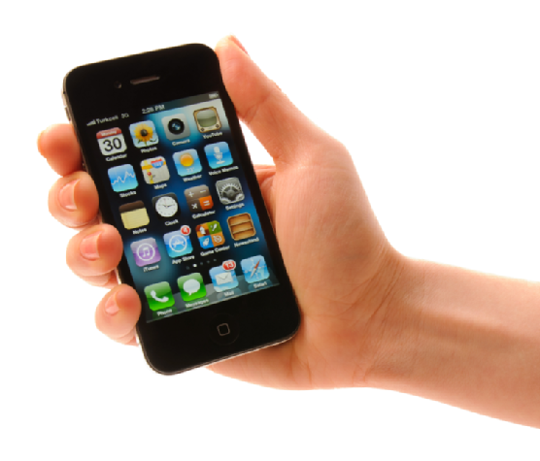
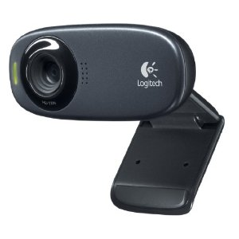
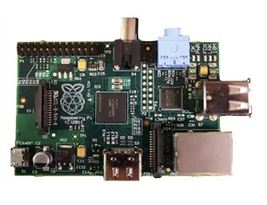

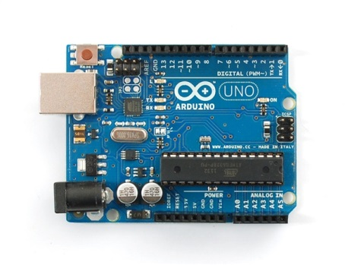
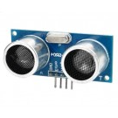
1) Here comes a caller
2) Proximity sensor outputs changed signal
3) Arduino sends changed signal to Raspberry Pi
4) Raspberry Pi instructs webcam to take picture
5) Webcam sends picture to Raspberry Pi
6) Raspberry Pi uploads picture and sends SMS to phone

Slide 5
Why this solution????
Reasonably inexpensive
Less than $100
Wanted to fiddle with hardware
Get to speak at conferences
Notes:
There are spycams that you can buy and install yourself – but they’re pretty expensive (as in more than $200).
Also, I didn’t find any that could be set up to notify me instantaneously when an event occurred and send me information such as a photo
With a date and timestamp

Slide 6
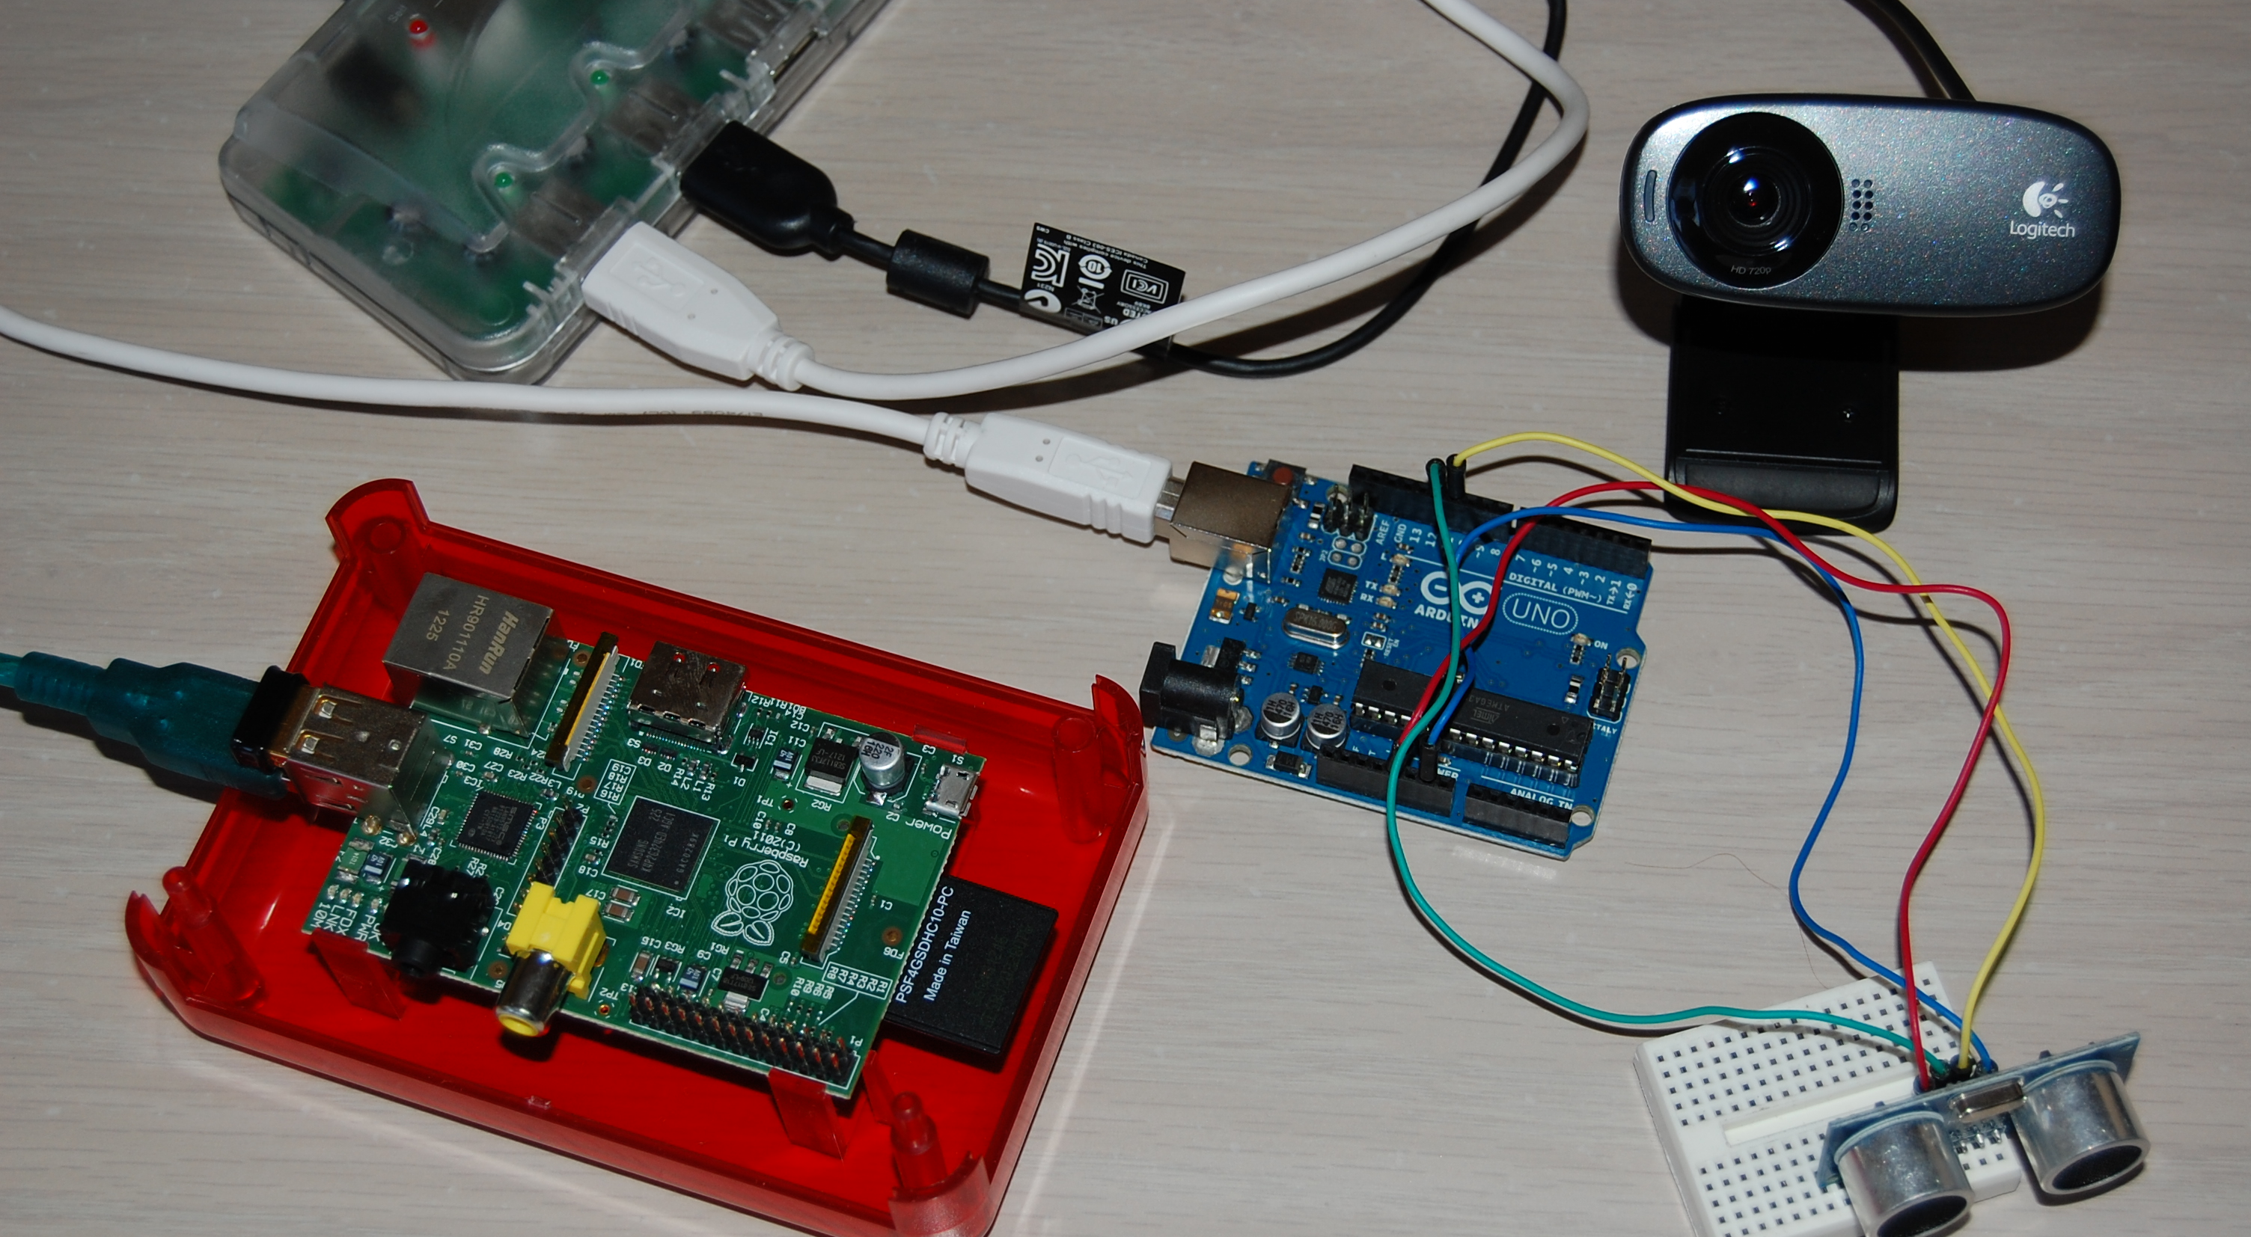
All the hardware I used

Slide 7
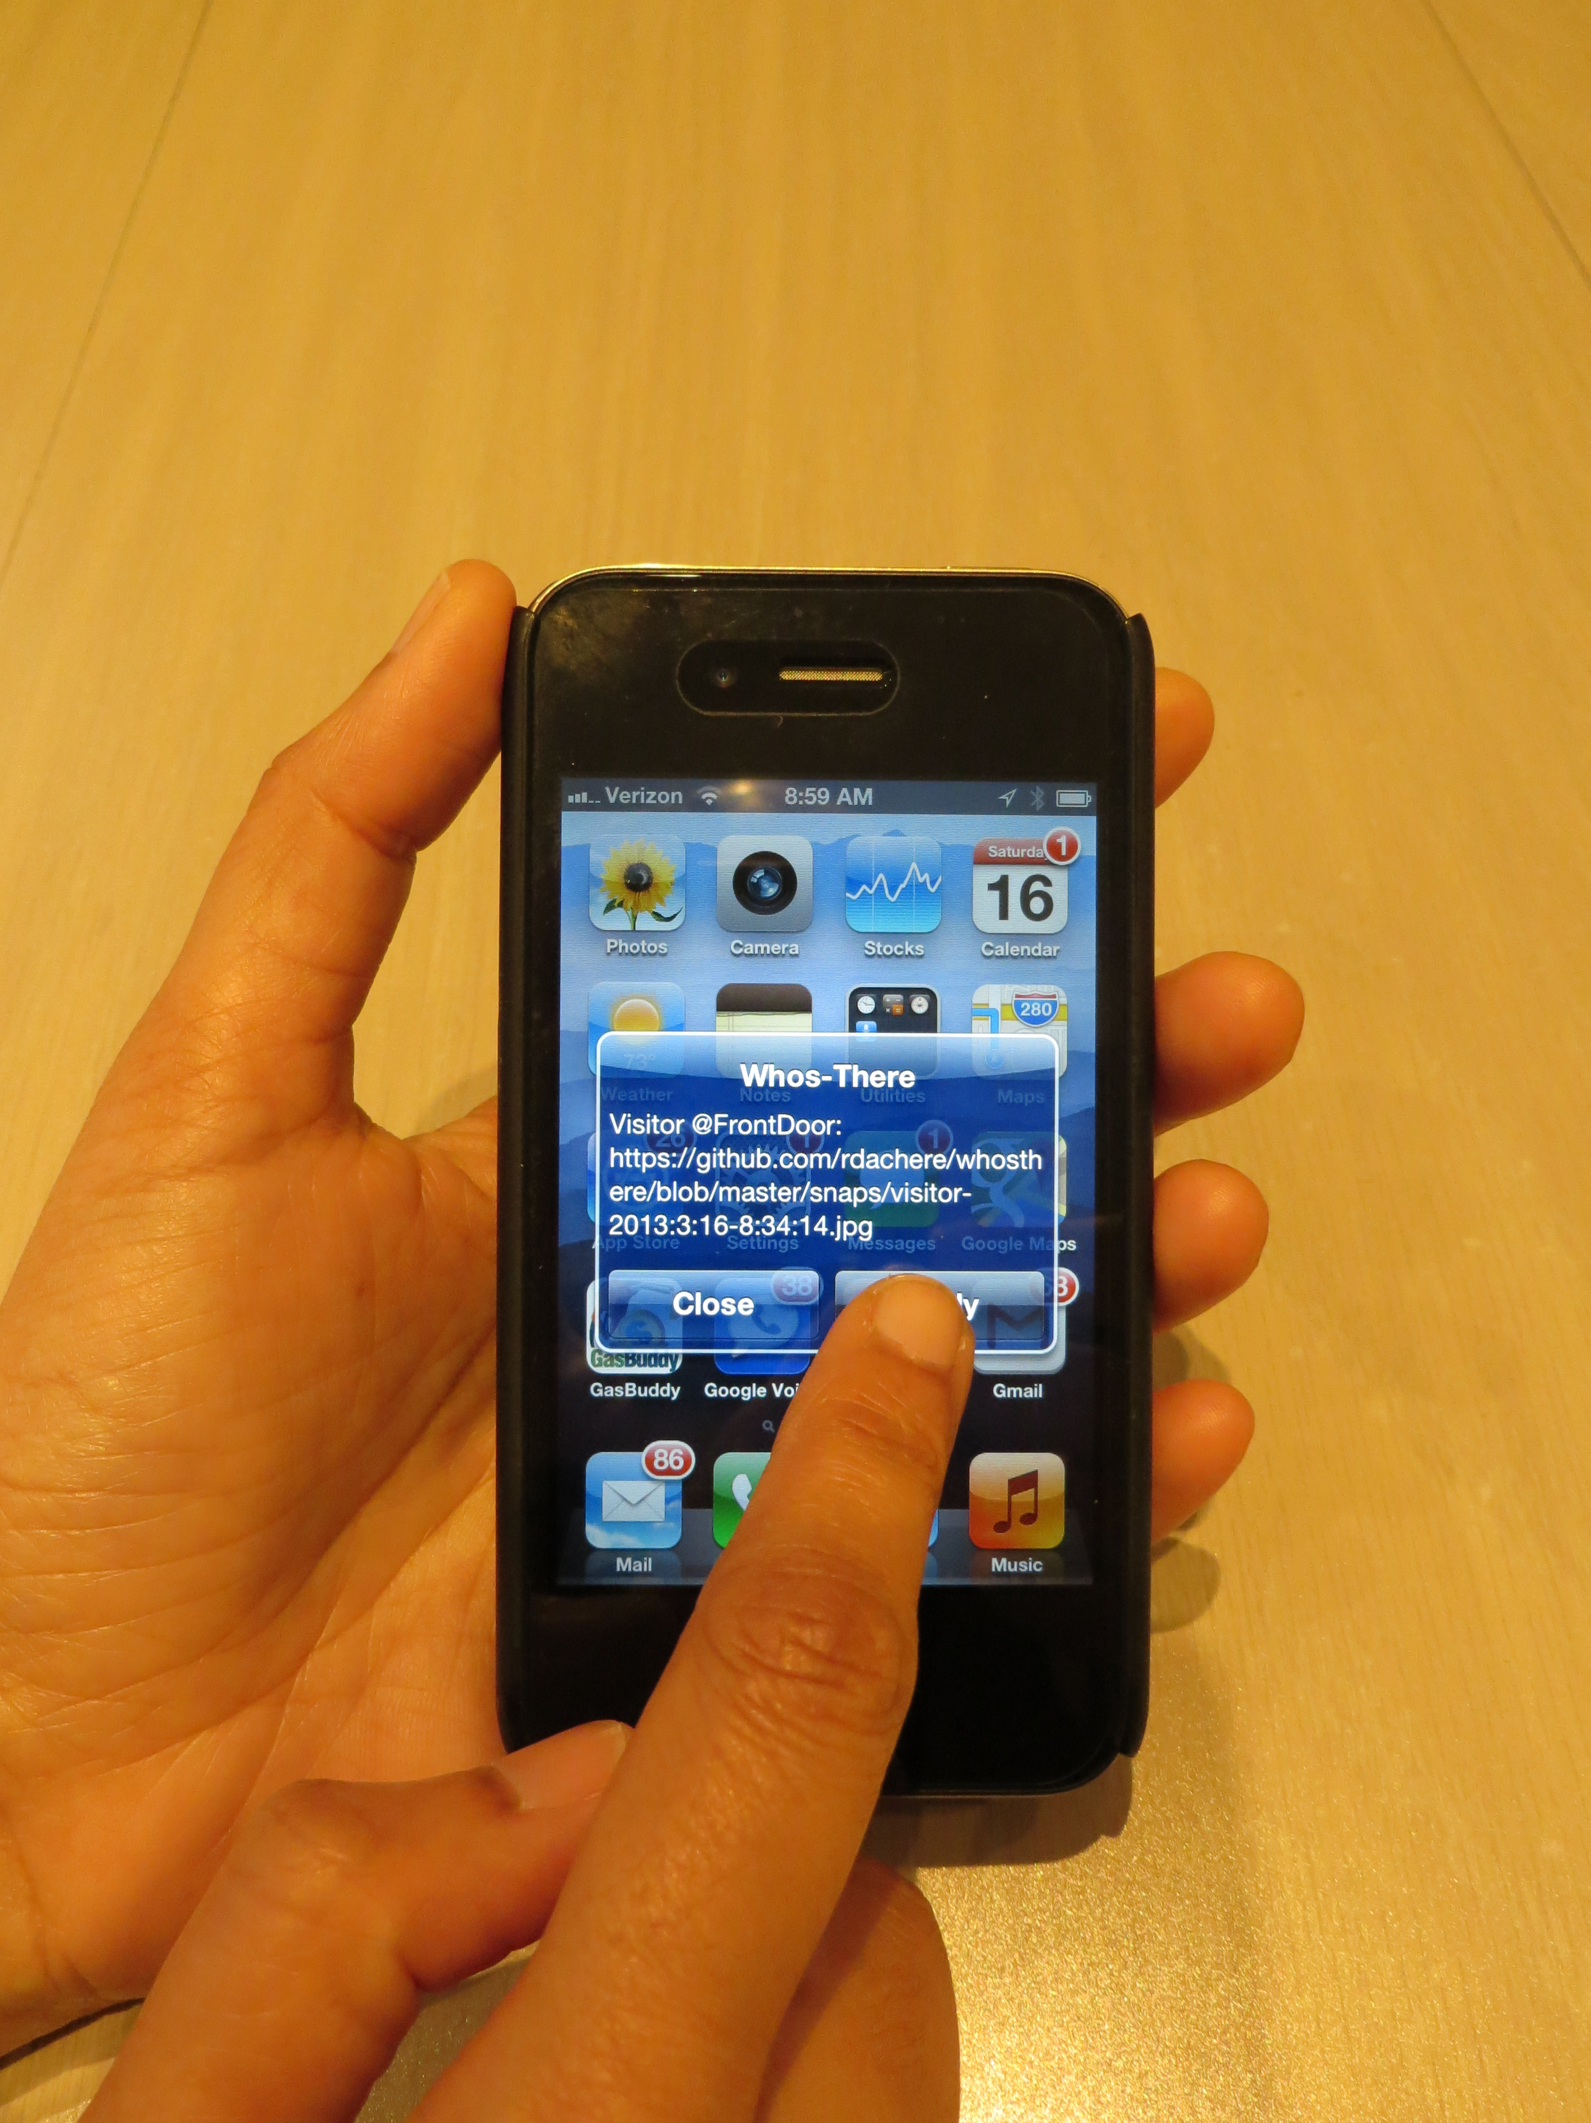
Final Result

Slide 8
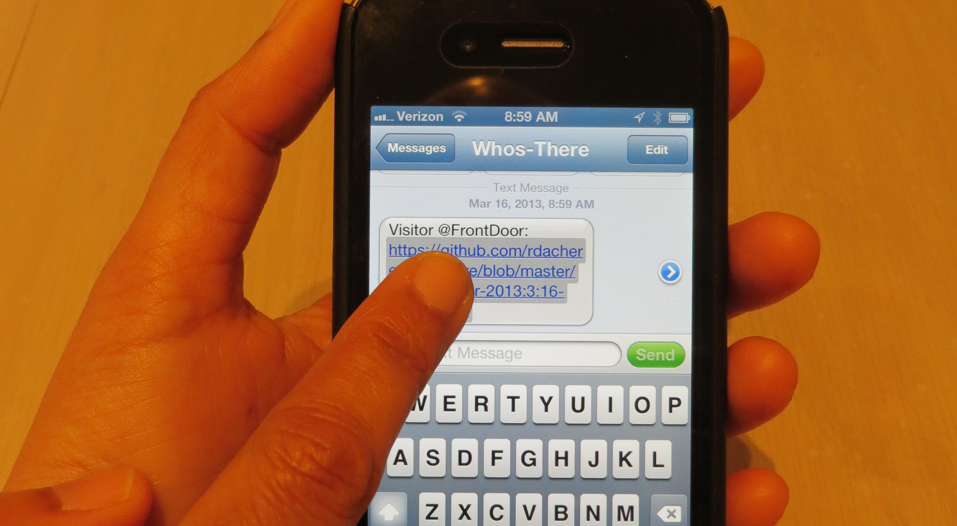

Slide 9
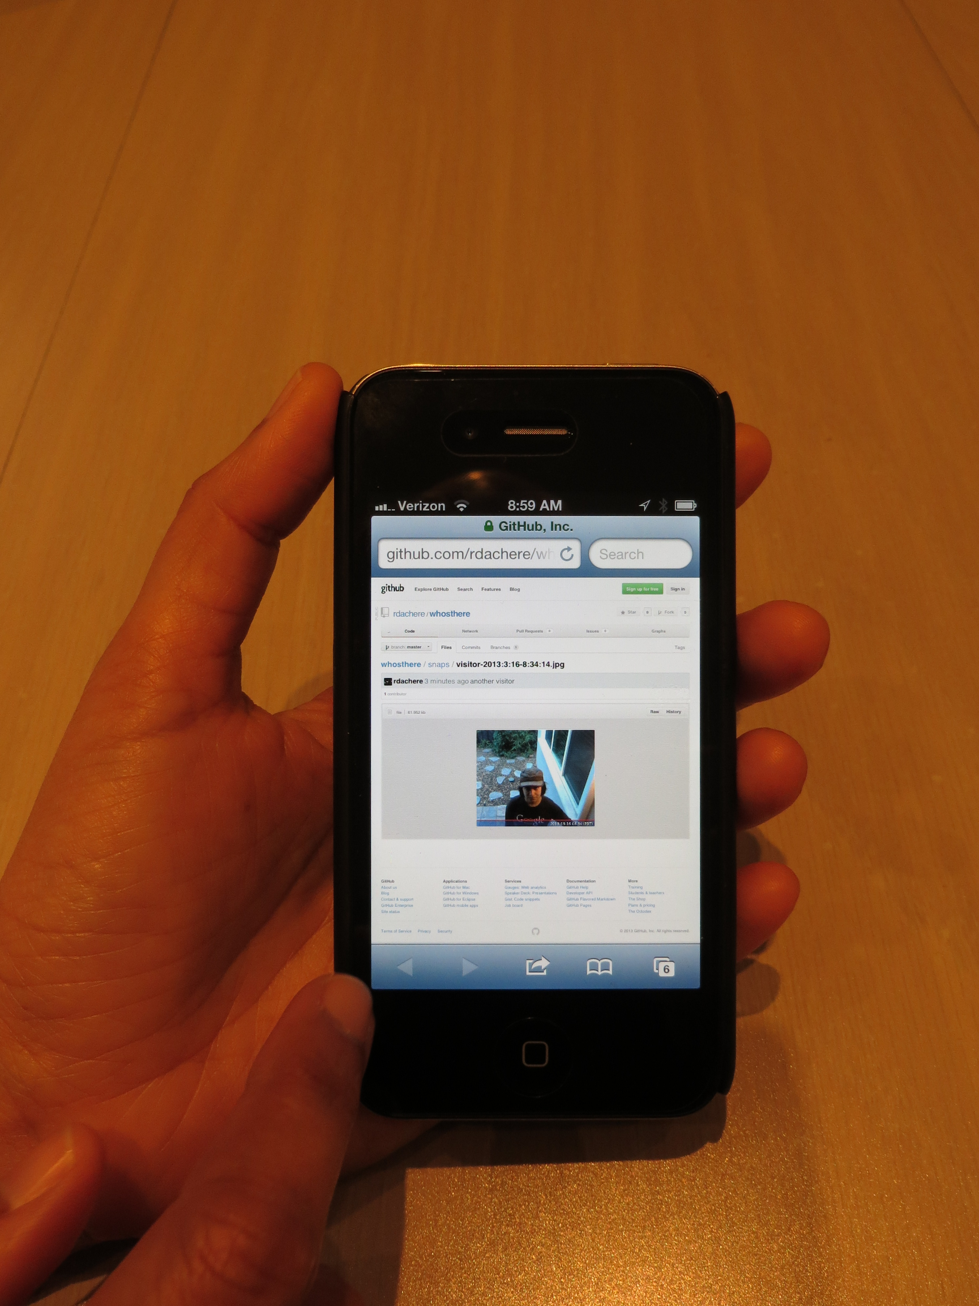

Slide 10
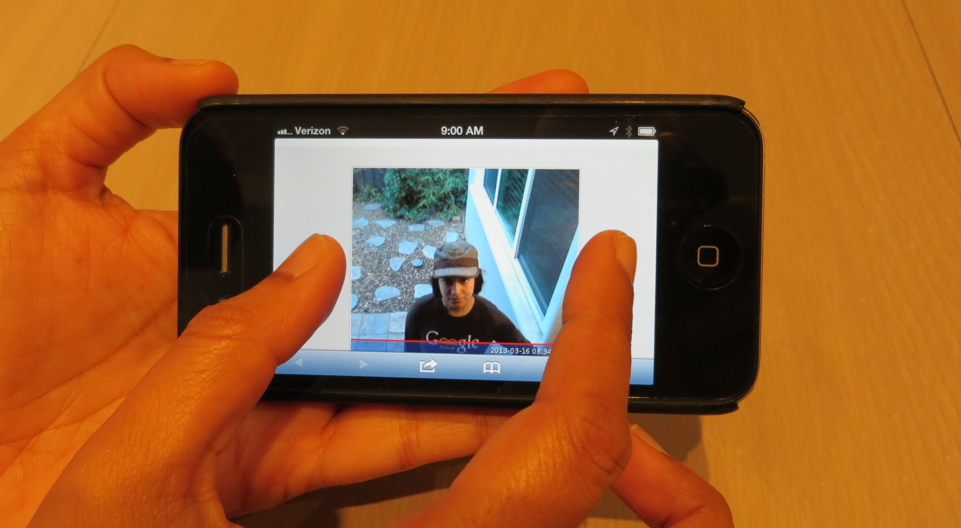

Slide 11
RaspberryPi vs Arduino
RaspberryPi | Arduino
Runs a full fledged Linux OS – full stack | Small “sketches” written in C-like language, can also use C++, limited memory
700Mhz micro-processor with 512MB of RAM (Microprocessor – can run different lingos – python, c++, java) | 16Mhz micro-controller with 32KB of Flash memory
Ethernet & SD card support | Neither
Doesn’t support Analog I/O | Supports Analog I/O
Not as many pins for IO as the Arduino | Many PINs available – easy to reach
Writing to the pins for time essential applications in Python can lead to inaccuracies | Is accurate with time sensitive applications
Notes:
Here is a brief comparison between the RaspberryPi and Arduino. I got this from a quick Google search. There are many other differences – these are just a few that I thought would be good to share.
Diff between micro-controller & micro-processor
A microprocessor generally does not have Ram, ROM and IO pins. It usually uses its pins as a bus to interface to peripherals such as RAM, ROM, Serial ports, Digital and Analog IO. It is expandable at the board level due to this.
A microcontroller is 'all in one', the processor, ram, IO all on the one chip, as such you cannot (say) increase the amount of RAM available or the number of IO ports. The controlling bus is internal and not available to the board designer.
This means that a microprocessor is generally capable of being built into bigger general purpose applications than a microcontroller. The microcontroller is usually used for more dedicated applications.
Arduino:
Flash Memory 32 KB (ATmega328) of which 0.5 KB used by bootloader
SRAM 2 KB (ATmega328)
EEPROM 1 KB (ATmega328)
Clock Speed 16MHz

Slide 12
Software I wrote
Arduino Sketch to read output from sensor
RaspberryPi python code – 2 scripts
Recognizer.py
Read sensor output from Arduino (one thread)
Detect Object
Take photo by sending message to webcam (fsbwebcam)
Upload the photo to a site (GitHub)
Call send_sms.py with URL to photo
Send_sms.py
Use Twilio to send URL to photo as an SMS/Text msg
Notes:
I use an Arduino sketch to read the output from the sensor and send it to the RaspberryPi
On the RaspberryPi, I have two python scripts

Slide 13
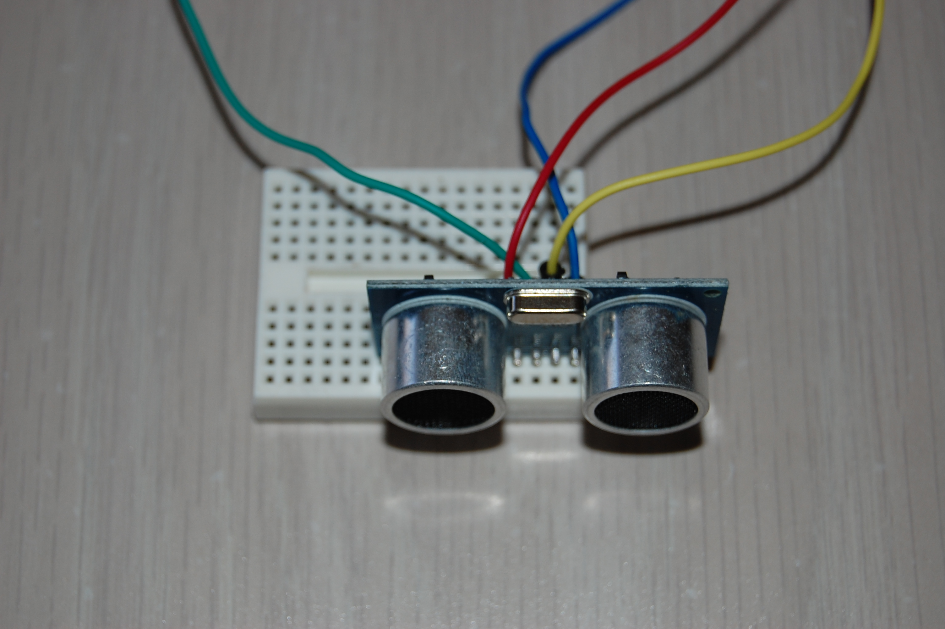
Proximity Sensor
HC-SR04
Notes:
Max range is 16 ft

Slide 14
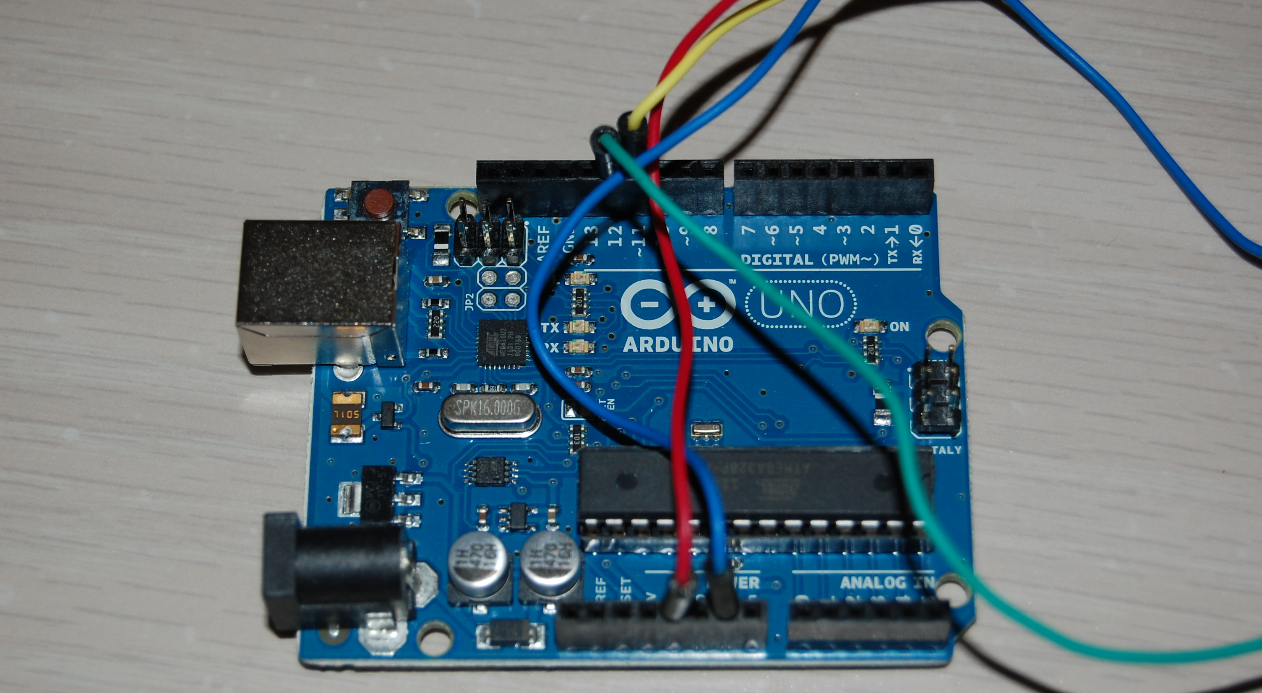
Arduino – Uno R3
Notes:
Explain different components of Arduino
The Arduino is a popular microcontroller platform consisting of a small, inexpensive board and an easy-to-use C-based development environment. The board has multiple digital I/O pins and analog inputs, and a USB serial port connection for programming and communication. The Arduino can be interfaced with a wide variety of hardware. (The Arduino is kind of like a Microchip PIC development board, but uses the ATmega328P AVR microcontroller.) The Arduino is about the size of a credit card (but thick). It has connectors on top which will receive a daughter board (inexplicably called a "shield"), or jumper wires.
The Arduino is very easy to program and use. The Arduino is programmed using the Wiring language, which is an extension of C with manylibraries to interface with various types of hardware. The Arduino IDE provides an editor and compiler for a "sketch" (which is the name for an Arduino program), and downloads the code to the Arduino board over USB. After seeing the Arduino hype at the Maker Faire, I got a Adafruit Arduino Starter Pack, and I've been happy with it. More information about the Arduino is at www.arduino.cc; the playground is a good place to start.
You can do a lot with an Arduino, but it has some limitations. There's only 30KB of memory for programming (yes, kilobytes). Many things you might want to connect (Ethernet, SD card, USB hard drive or flash) require additional hardware, and even then are pretty limited.
Arduino: is a microcontroller based physical computing platform,programmed using a Wiring-based language (syntax and libraries), similar to C++ with some slight simplifications and modifications, and a Processing-based integrated development environment. With the Arduino Uno you would need to create a sketch in the Arduino language. This is not hard - it looks very C-like. It is just something you have to do. There are a ton of libraries and classes for Arduino.
Raspberry pi: is a microprocessor based single-board computer running linux, you can program for it in C++, Java, python or some other language you may already be comfortable with. You may indeed be able to take an application you already have and compile it to run on the Pi / Due without making any changes, also it integrates with Qt in so many ways.

Slide 15
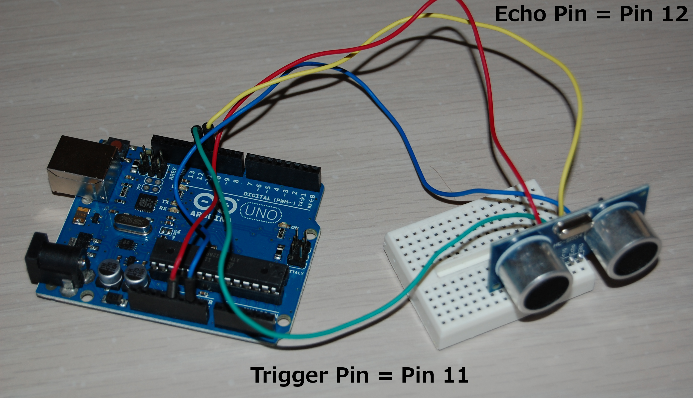
Arduino + Sensor Setup
Notes:
Pin 11 is the Trigger Pin
Pin 12 is the Echo Pin
Red goes to power (Vcc)
Blue goes to ground
Write sketches (short scripts) in the Wiring language (very C-like)

Slide 16
Arduino Dev Setup
Download dev kit – arduino.cc
Connect via USB to Mac/PC/*nix
Look at example sketches – blinking lights etc.
That’s it – really *simple*

Slide 17
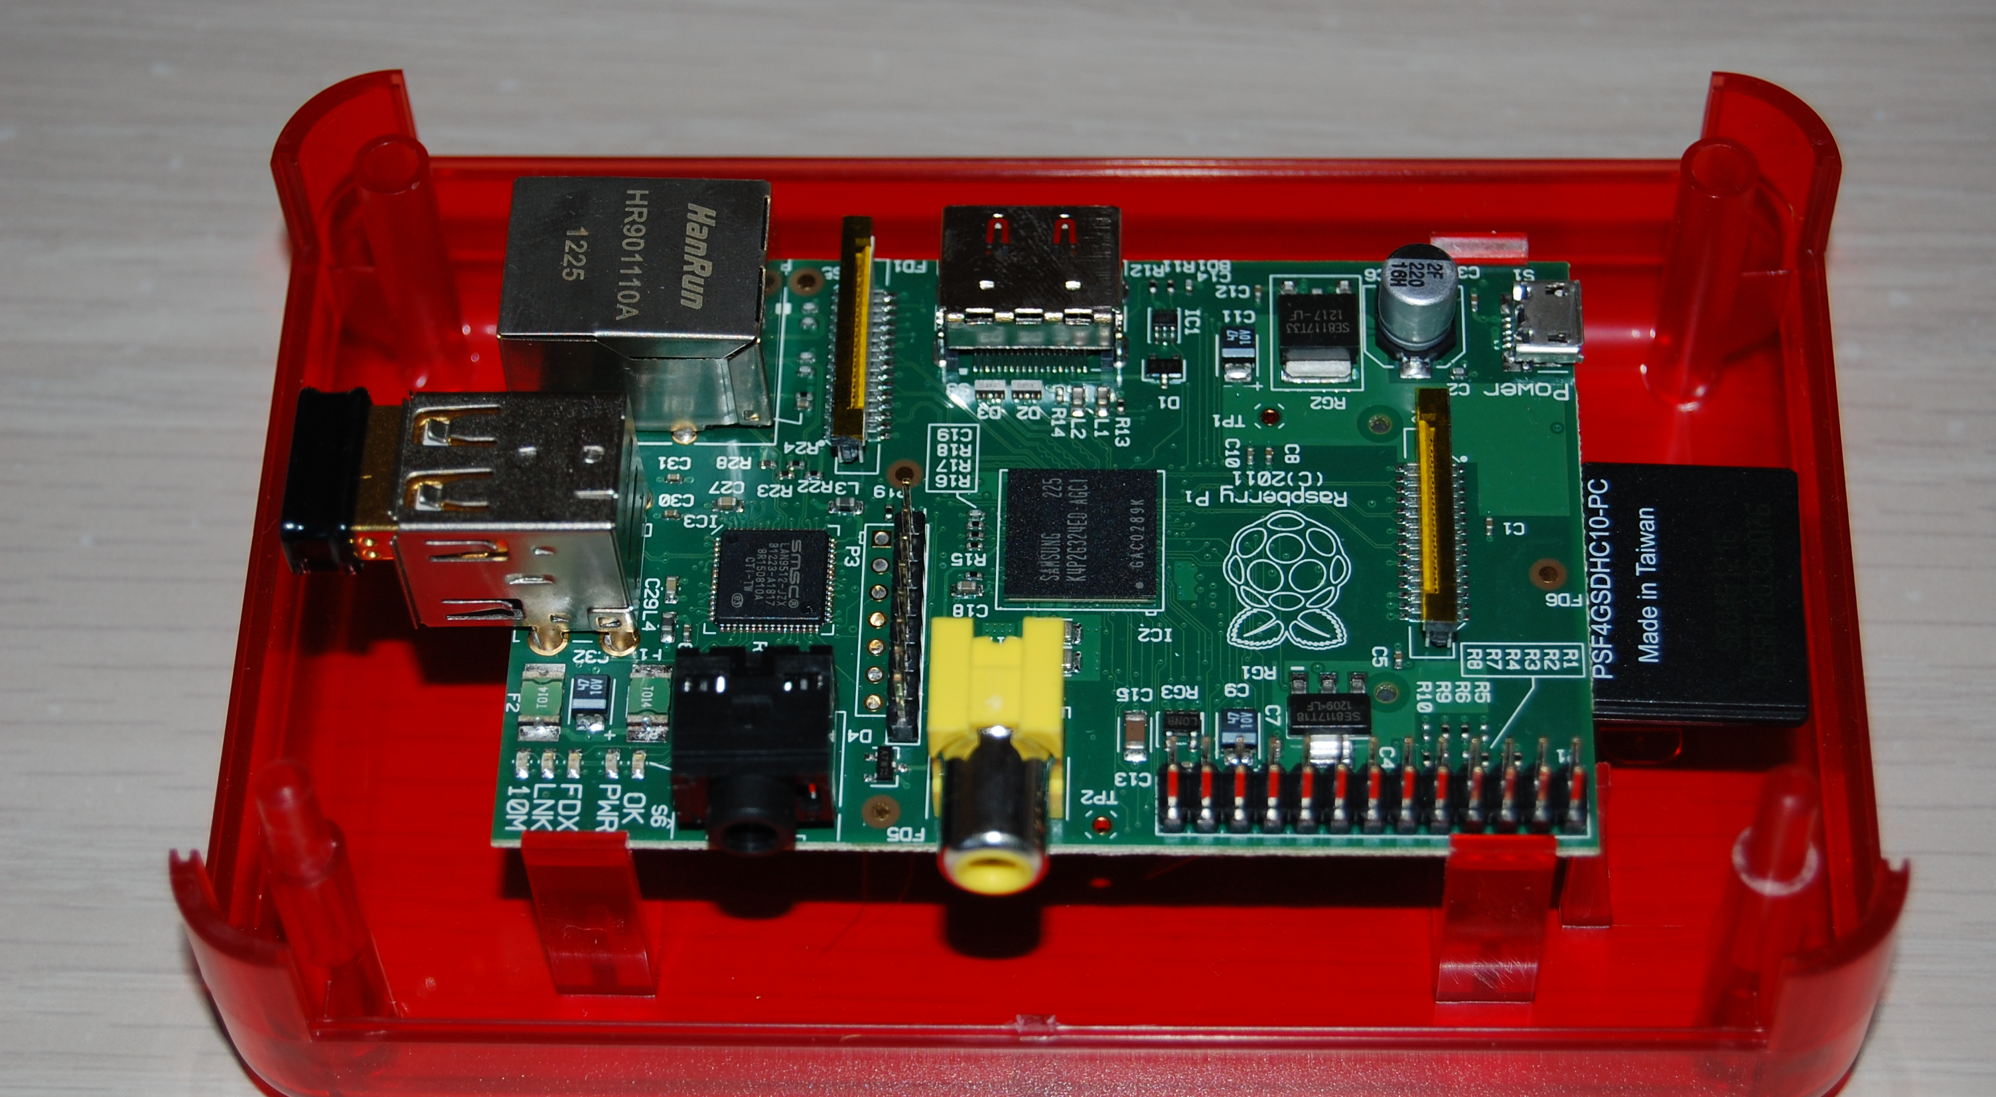
RaspberryPi
Notes:
Explain the different components of Rpi
Pi == “Python”

Slide 18
Raspberry Pi Development Setup
2012-12-16-wheezy-raspbian.img
Install pip, pyserial – apt-get pip install
Libraries for Twilio Api
Output from Arduino on /dev/ttyACM0
Notes:
Rpi Dev setup

Slide 19
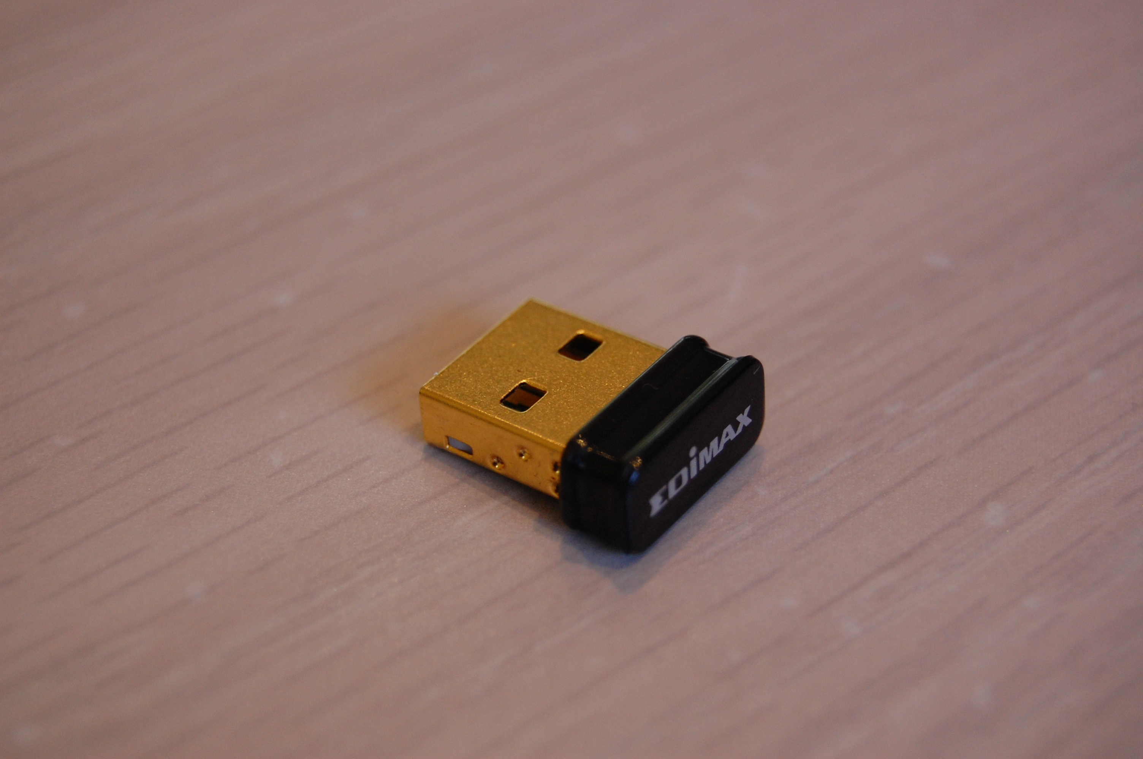
Wifi Dongle
EdiMax EW-7811Un 150 Mbps Nano
Notes:
This was about $8….
Supports 802.11n

Slide 20
Demo
Walk in front of the proximity sensor
See detection of foreign object
Trigger webcam to take photo
Save in file with date/timestamp
Upload file to Github
Send SMS to smartphone with URL of photo on github - My phone will ring a loud bell

Slide 21
Arduino Sketch Code
#include <NewPing.h>
#define TRIGGER_PIN 12 // Arduino pin tied to trigger pin on the ultrasonic sensor.
#define ECHO_PIN 11 // Arduino pin tied to echo pin on the ultrasonic sensor.
NewPing sonar(TRIGGER_PIN, ECHO_PIN, MAX_DISTANCE);
void loop() {
delay(1000); // Wait 1 sec between pings
unsigned int dist_inches = sonar.ping_in();
Serial.println(dist_inches);
}
Notes:
Here’s the code for the arduino sketch –
#define MAX_DISTANCE 200 // to ping for (in centimeters). Maximum sensor distance is rated at 400-500cm.
Initially there’s some setup for the pins on the sensor ( trigger, echo) and max distance – 200 cm = 78 inches. Max distance for the sensor is 500cm = 16 ft.
Lowest frequency is 20x/sec
Not sure what the Echo is for – I believe the Trigger pin is the one that generating the data. I think the Echo is used to determine the distance – it’s held high for some time
The library includes 3 functions:
1. Ultrasonic(int TP, int EP)
This is a initial function for ultrasonic ranging module, choose the pins for module TRIG and ECHO pin. For example:
Ultrasonic(13,12);
defines the digital pin 13 of Arduino as the TRIG pin of HC-SR04 and pin 12 for the ECHO pin.
2. long Timing()
This function triggers the ultrasonic module and returns the duration that the ECHO pin was held high. For example:
long time; Ultrasonic hcsr; time = hcsr.Timing();
The distance of the object corelates to the time the ECHO pin is held high. The distance formula is:
Distance = ((Duration of high level)*(Sonic :340m/s))/2
3. long Ranging(int sys) — (sys : CM / INC)
If you don’t want to change the time into distance yourself, this function will help you get the distance immediately. This function has a parameter (using CM or ICN) that shows the distance in centimeters or inches. This function will call Timing() and you don’t need to use the Timing() before it. For example:
long distance; Ultrasonic hcsr; distance = hcsr.Ranging(CM);
returns the distance in centimeters.

Slide 22
RaspberryPi Code (1/6)
Recognizer.py:
class Arduino(threading.Thread) :
def run(self, interactive) :
# Port may vary, so look for it:
baseport = "/dev/ttyACM0"
self.ser = serial.Serial(baseport, 115200, timeout=800)
Notes:
Create a thread and do some basic initialization for the input from the arduino
set the device info.
Baud rate is 11.5 meg at 800 ms

Slide 23
RaspberryPi Code (2/6)
# threshold to mitigate butterflys/moths
valid_pic_count = 0
while True :
data = self.ser.readline().strip()
if data :
if interactive : #good for testing
if int(data) < MAX_TRIGGER_DISTANCE:
#set to a default of 30 inches
print "Detected something -", data

Slide 24
RaspberryPi Code (3/6)
valid_pic_count += 1
if valid_pic_count == VALID_PIC_THRESHOLD:
# get current date and timestamp
now = datetime.datetime.now()
#build snapshot filename with date and timestamp
snapshot_filename = "visitor-%d:%d:%d-%d:%d:
%d.jpg" % (now.year, now.month,
now.day, now.hour,
now.minute, now.second)

Slide 25
RaspberryPi Code (4/6)
take_snapshot_cmd = ”fswebcam ./snaps/" + snapshot
snapshot_return_code =
call(take_snapshot_cmd ,shell=True)
#reset valid_pic_count
valid_pic_count = 0

Slide 26
RaspberryPi Code (5/6)
print "Doing GIT stuff....”
do_git_stuff = "git add
BASEDIR_FOR_GIT_IMAGES;
git commit -m \"another visitor\”
BASEDIR_FOR_GIT_IMAGES;
git push”
git_cmds_return_code = call(do_git_stuff,
shell=True)
Call send_sms with GIT URL

Slide 27
RaspberryPi Code (6/6)
Send_sms.py: Uses Twilio API
parser.add_option('-u', '--sms_url’, action="store", dest="sms_url”, help="sms url string",
default="spam”)
options, args = parser.parse_args() #parse the cmdline arg for URL
body_url = "Visitor @FrontDoor: " + options.sms_url
message = client.sms.messages.create(
to="+XXXYYYZZZZ",
from_=”+PPPQQQRRRR”,
body=body_url)

Slide 28
Hardware & Cost
Arduino Uno R3 - $22
Proximity Sensor – $16
Raspberry Pi - $35
Webcam – Free (from my junk pile)
Edimax Wifi Dongle - $12
USB Hub – Free (from my junk pile)
Breadboards (small), wires - $5
Total = $90
Notes:
Sensor –
Power Supply :5V DC
Quiescent Current : <2mA
Effectual Angle: <15°
Ranging Distance : 2cm – 500 cm/1" - 16ft
Resolution : 0.3 cm

Slide 29
Attributions
www.adafruit.com
www.sparkfun.com
www.arduino.cc
www.raspberrypi.org
www.shallowsky.com/arduino
I didn’t use: Various books on Arduino and RaspberryPi.

Slide 30
Contact & Code/Slides
Rupa Dachere – rupa@codechix.org
Source Code & Slides:
Github.com/rdachere/whosthere
Notes:
Here’s some info on me and where you can get the source code and the slides for this talk:
I’m Rupa Dachere. I’m the Founder and President of CodeChix.org which is a CA nonprofit public benefit corporation.
I can be reached at “rupa@codechix.org”.
And the source code and slides will be up on my GitHub account at “Github.com/rdachere/whosthere”

Slide 31
Tips and Lessons Learned
RaspberryPi could not detect Arduino or Webcam – USB Hub separate PS
Standard library for sensor didn’t work
Pins and Baudrate were different
http://code.google.com/p/arduino-new-ping/wiki/Simple_NewPing_Example
Modified detection distance to inches
Modified frequency to every second

